Slide 1


Submitted by:
Akash Kanjwani

Slide 2
ACKNOWLEDGMENT
During the process of completing this project, I have referred following materials for which I owe them great gratitude.
Data collection- Using Web scraping tool i.e. Selenium
Car24.com for collecting the data easemytrip.com/
Data trained video tutorials.
Scikit-learn https://scikit-learn.org/stable/
Machine Learning for Dummies by John Mueller and Luca Massaron - Easy to understand for a beginner book.
Geeksforgeeks. https://www.geeksforgeeks.org/
Besides that all the observation, creations of the models and graphs done by self help.

Slide 3
Problem Statement Flight ticket prices can be
something check out will be a
hard to guess, today we might see a price, the price of the same flight tomorrow, it different story. We might have often heard
travellers saying that flight ticket prices are so unpredictable.
Motivation for the Problem Undertaken
There are two main use cases of flight in the travel industry. OTAs and other integrate this feature to attract more
price prediction travel platforms visitors looking
for the best rates. Airlines employ the technology to forecast rates of competitors and adjust their pricing strategies accordingly.
Analytical Problem Framing
Mathematical/ Analytical Modelling of the Problem
The size of table is 8946*6 i.e. no. of rows are 8946 and no. of columns are 6(including target).
All the columns are object type in nature because we got the data using web scraping, In the upcoming steps we will change it where necessary.
Null values are not present in the data set as we can see in this seaborn heatmap, so there is no need to adopt imputation technique, but we can get some blank spaces, so we will drop that blank spaces.
In case of object data type, we will apply the encoding technique to convert the values in the numeric format.
In order to scrape the data we got some garbage data as well like:
  Price column is present in the the form of object datatype.
  In every row of price column comma(,) was
present.

Slide 4
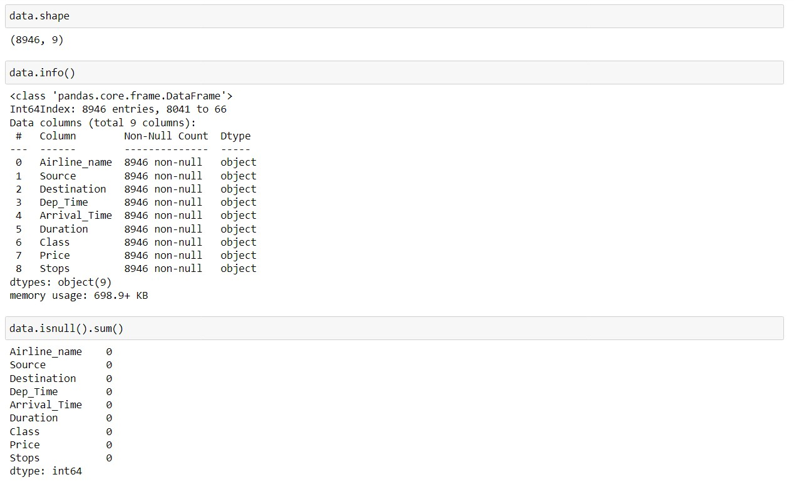
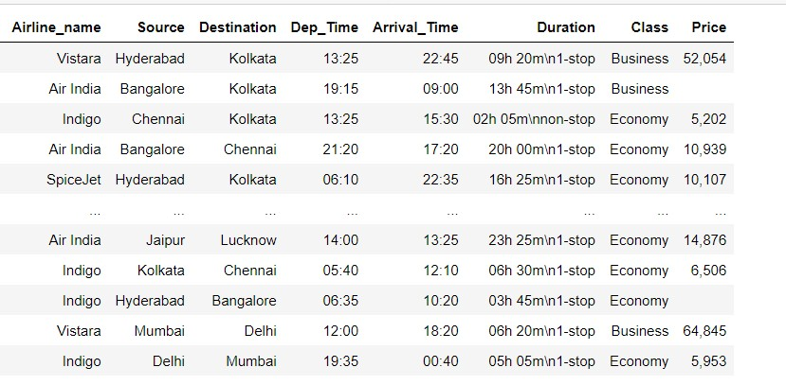
we had some empty space in between the columns.
We done some changes in the stop column because 1-stop had been written in the some other formats, so we changed that and winded up in the 1-stop name.
All the above garbage data we removed from the dataset with the help of pandas functions.
In our dataset only 1 columns are showing some outliers that is price. Because the mean is 23062 and standard daviation is 21016 and maximum max values is 100947 which is very higher and reason of outliers.
High Skewness is present in the kilometers driven
column(1.19), shows that data data are not equally distributed.
Data Sources and their formats
Initially we did not data, For getting the data we used web scraping selenium tool Data source- easemytrip.com

Slide 5
Data Pre-processing Done
Outliers, Skewness, Data scaling, Data Cleaning
Because we had categorical data and absence of numerical data that is why there was no column which can contain outliers and skewness only we had one column i.e. price column, which is numerical in
nature but column.
For Data
Encoding
here we can not pre-process the target
scaling we used Min max scaler.
the data with the help of label encoder.
* Data cleaning using pandas function

Slide 6
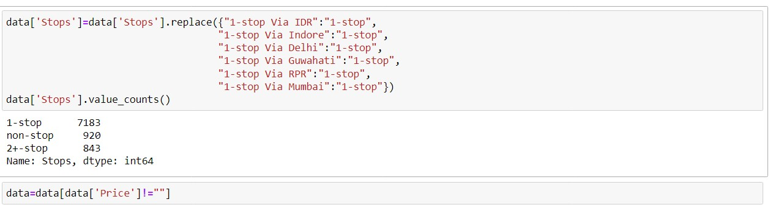
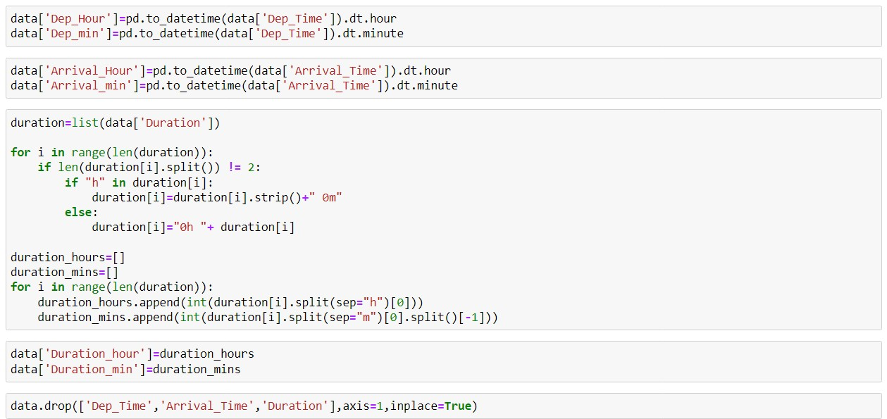
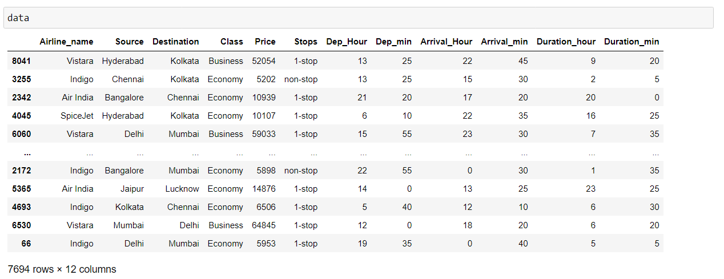

Slide 7
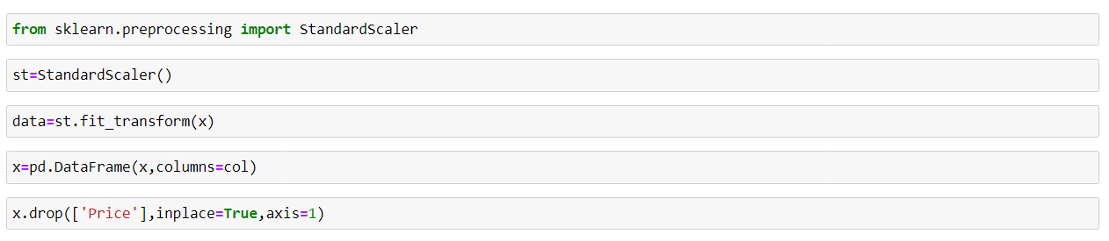
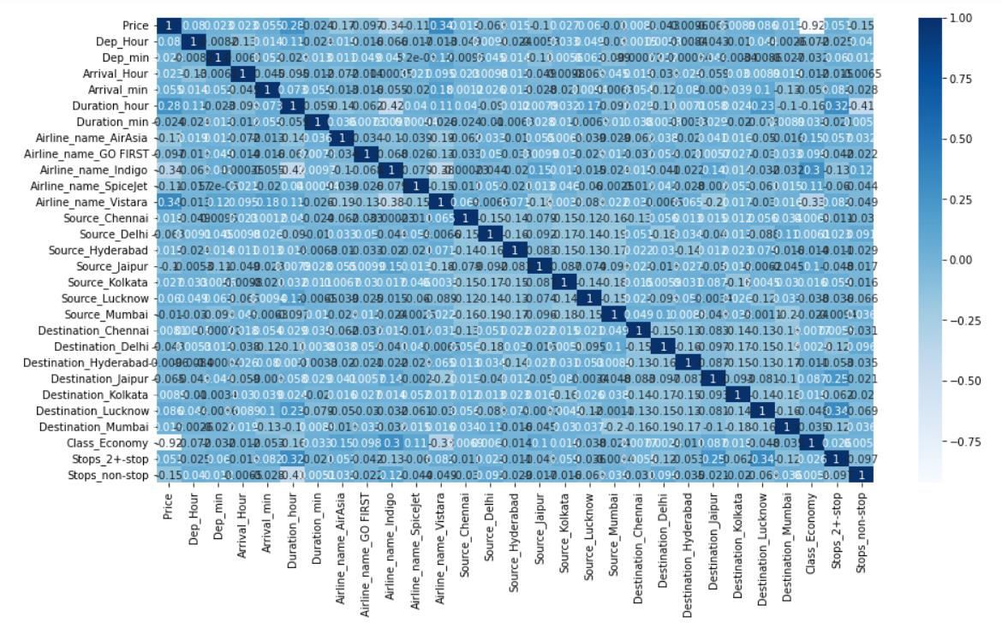
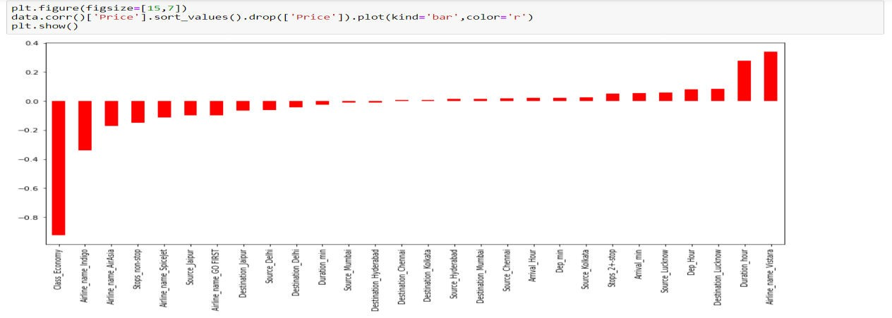
Scaling the data
Data Inputs- Logic- Output Relationships

Slide 8
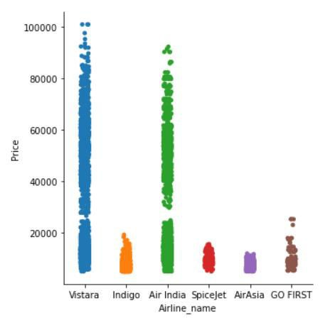
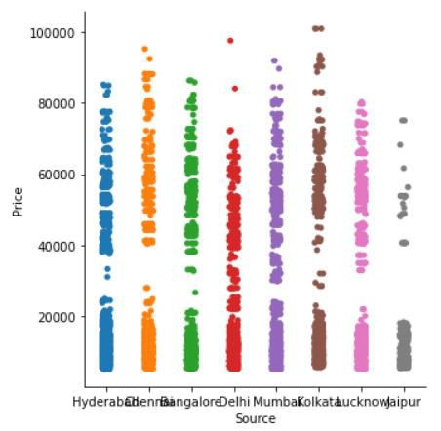
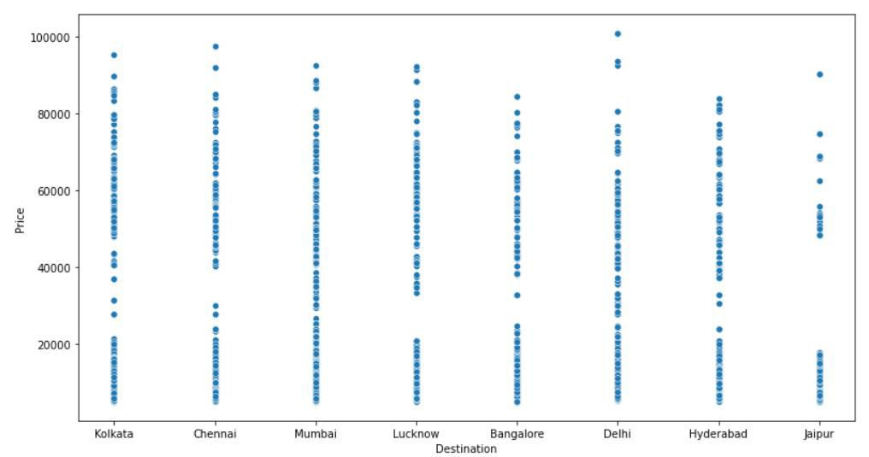
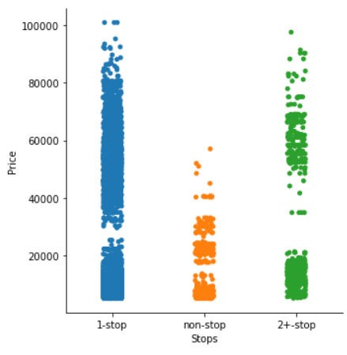
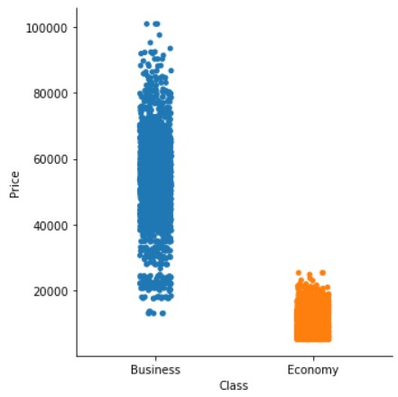

Slide 9
Price of Vistara and Air india are higher as compare to other airlines.
The Ticket price of all the sources and destinations are around same with veay less diffrence.
The Ticket price is higher when the class type is business.
Most of the airlines takes 1 or 2 stops to reach the destination point, and very less flights takes 0 stops to reach the destination point.
Hardware and Software Requirements and Tools Used
Anaconda Navigator Jupyter Notebook Language-Python Selenium
Many lib.-------
import import import import import import
pandas as pd matplotlib.pyplot as plt seaborn as sns
numpy as np warnings selenium
warnings.filterwarnings('ignore')
from from from
sklearn.preprocessing import power_transform scipy.stats import zscore sklearn.preprocessing import MinMaxScaler
import statsmodels.api as si

Slide 10
from scipy import stats from statsmodels.stats.outliers_influence
import sklearn
from sklearn.linear_model import LinearRegression,Lasso,Ridge,ElasticNet
from sklearn.model_selection import train_test_split,GridSearchCV,cross_val_score
from from from from
sklearn.tree import DecisionTreeRegressor sklearn.svm import SVR
sklearn.neighbors import KNeighborsRegressor sklearn.ensemble import
RandomForestRegressor,AdaBoostRegressor,GradientBoost ingRegressor
import xgboost as xg from sklearn.metrics
import mean_squared_error,mean_absolute_error,r2_score
Pandas- For making data frame
Matplotlib and seaborn- For data visualization
Numpy- For numerical python
MInMAxScaler- For data scaling
Power transform-For removing skewness
From metrice - mean_squared_error,mean_absolute_error,r2_score checking the model accuracy.
Regression- For regression modeling
Ensamble- For boosting and bagging
Grid search cv- For hyperparameter tuning
Cross_Val_Score- For cross validation
-For
Model/s Development and Evaluation
Approaches Firstly it is import to know about which type of modelling we are going to construct, For this

Slide 11
problem we used regression models because our target
variable is numerical flight price. When we use some metrics like
type and we had to predict the go for regression we have to mean_squared_error,
mean_absolute_error, r2_score In order to do this work we have to find out the best random state by which we can achieve good accuracy. Then we split our
data set into the train test split. have to use cross
train part and test part using When we done with the modelling we validation for real
accuracy(without underfitting and overfitting). Hyperpameter is must for increasing the model
accuracy in order to build good model for this we use Grid search cv. We followed all the above
to build our Machine learning
Algorithms
Linear Regression
model.
approaches
Decision Tree Regressor
KNeighbors Regressor
Support Vector Regressor
  Ridge regressor
  Lasso regressor
For Bagging and boosting:
Random Forest Regresssor
Gradient Bossting Regressor
AdaBoost Regressor
XgBoost Regressor

Slide 12
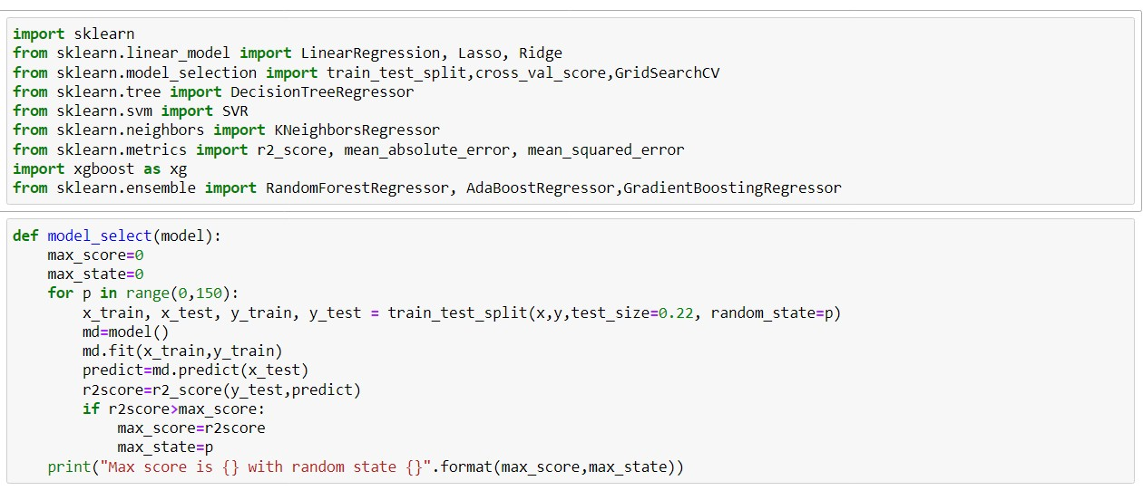
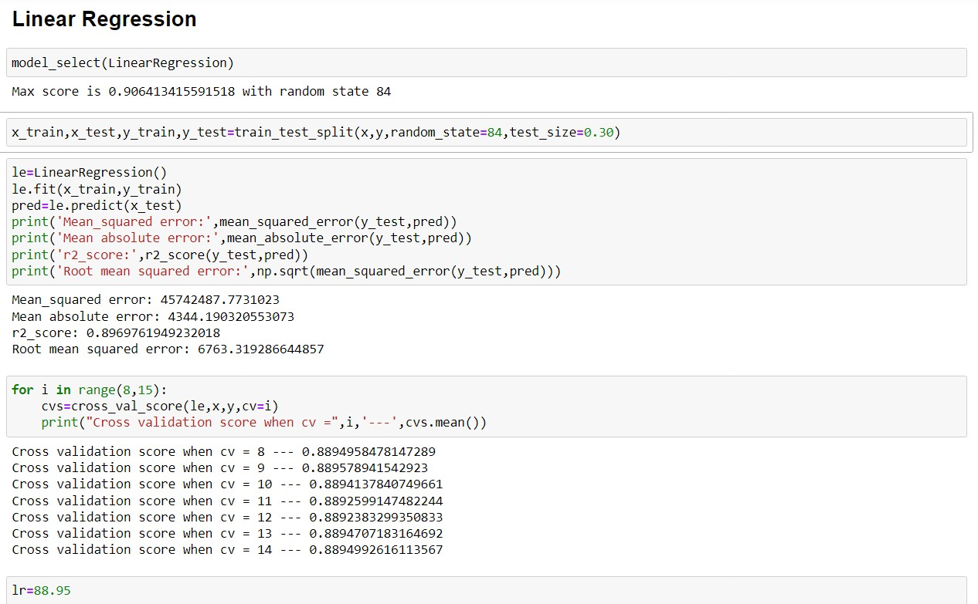

Slide 13
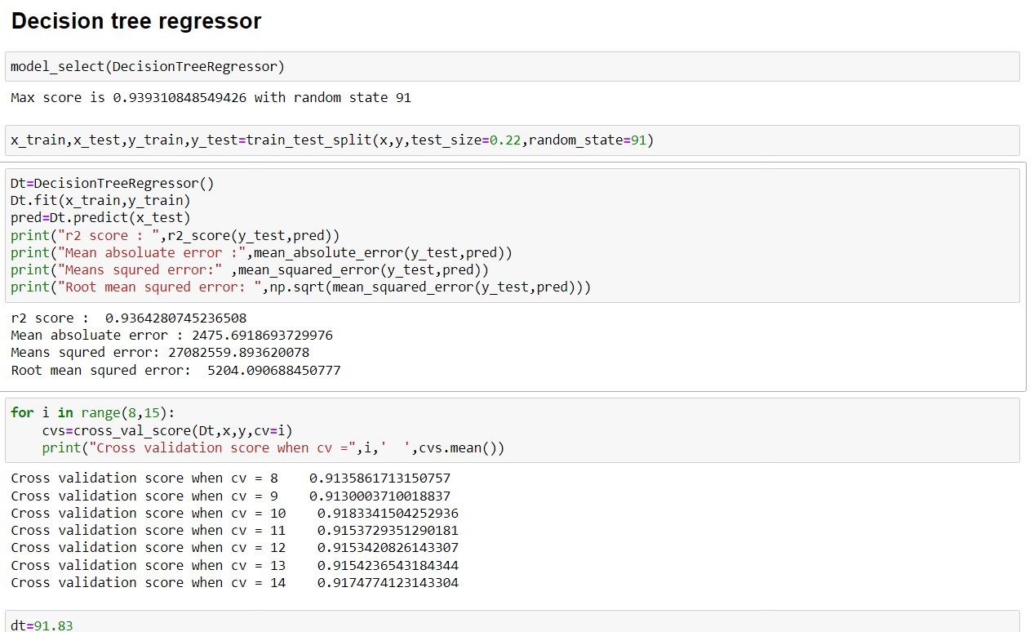
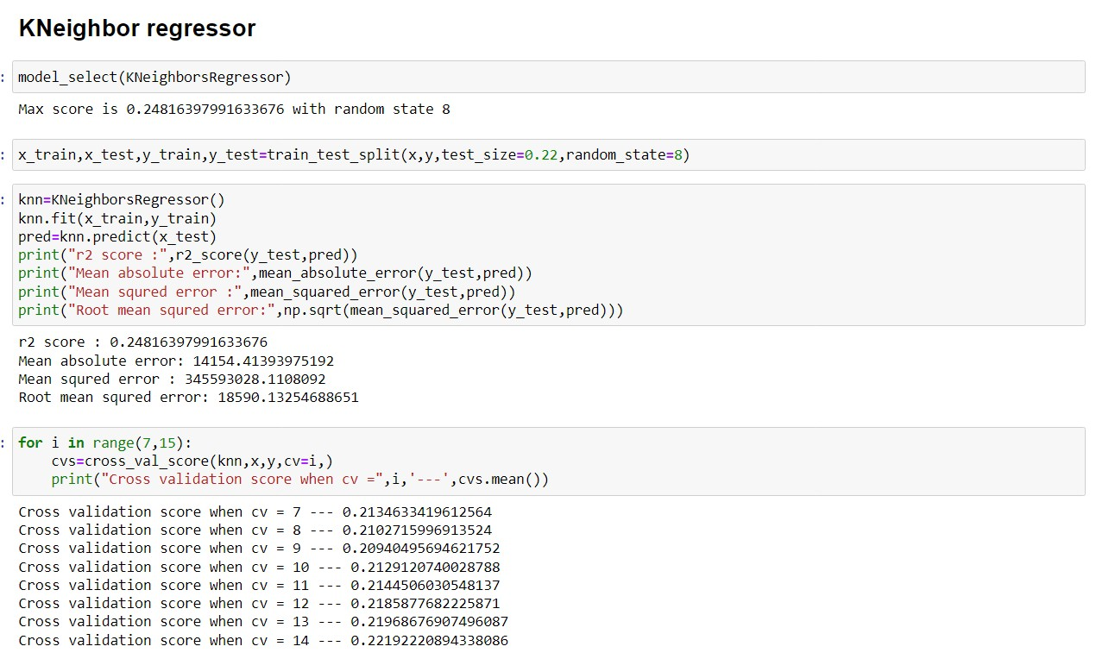

Slide 14
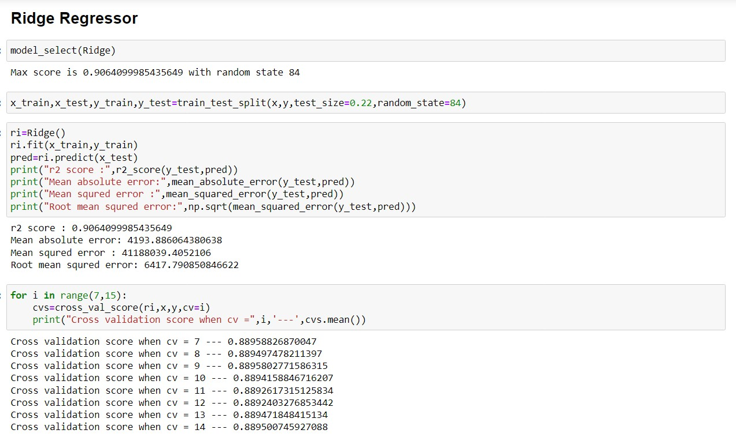
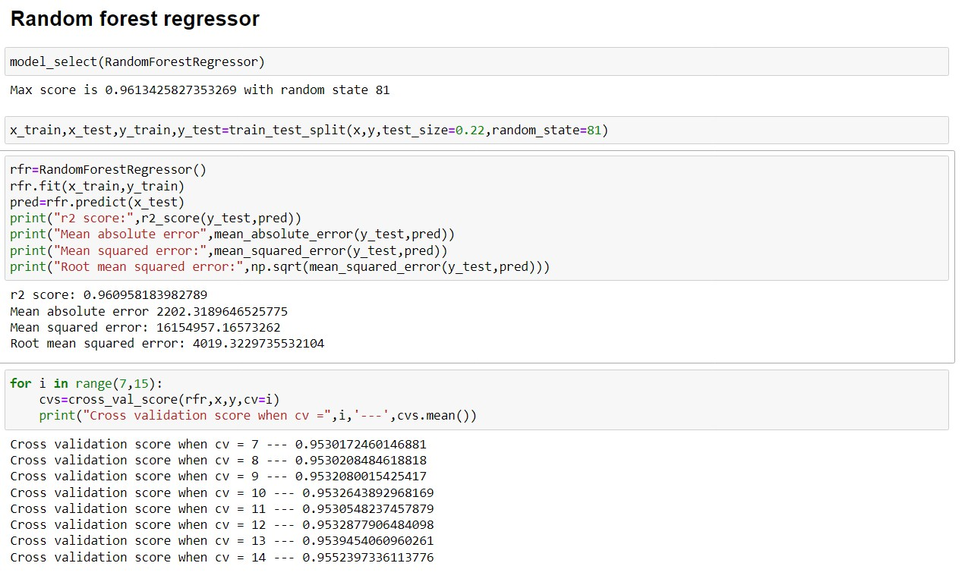

Slide 15
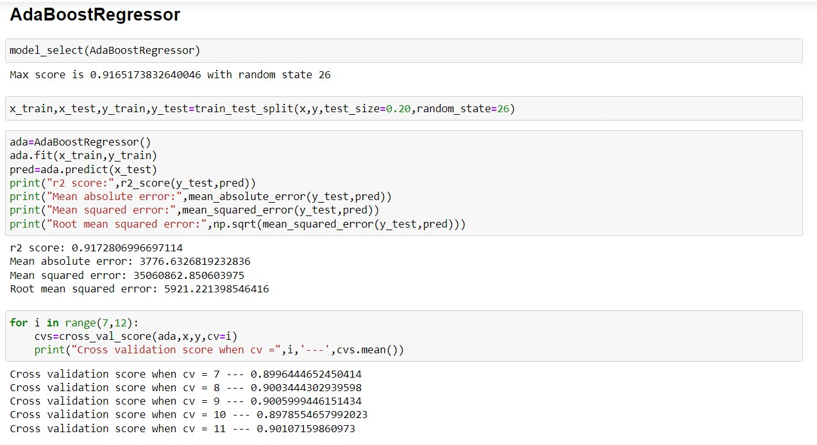
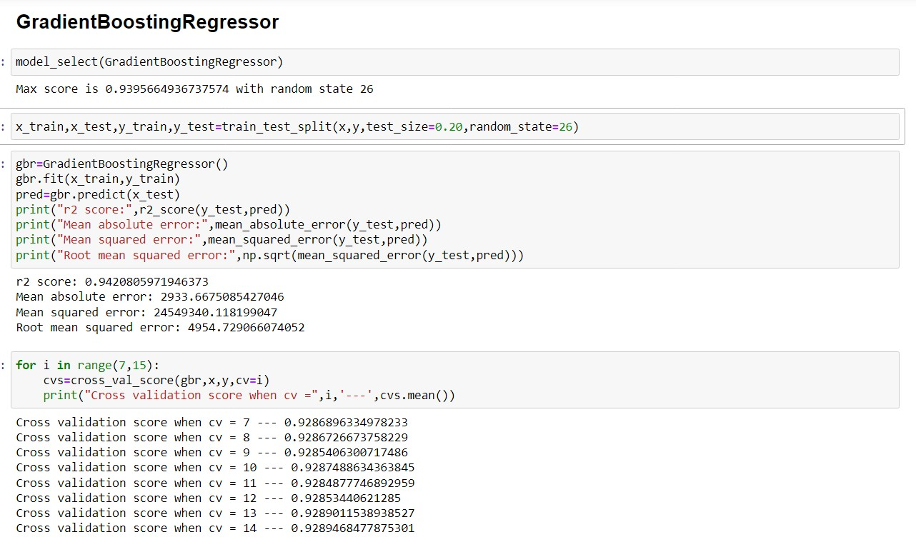

Slide 16
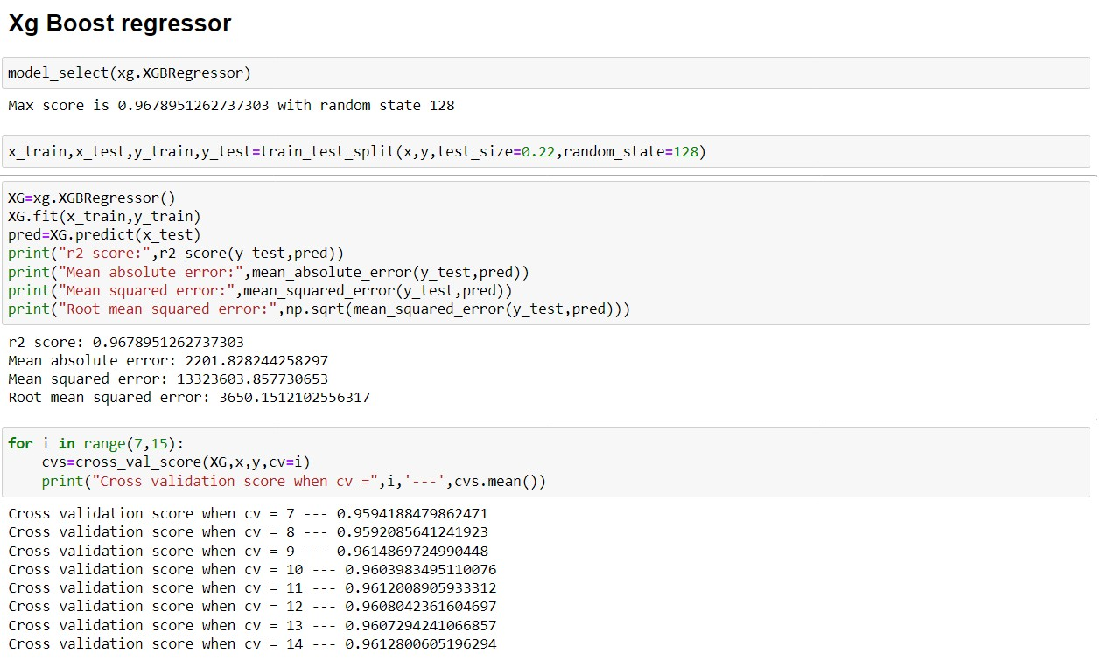
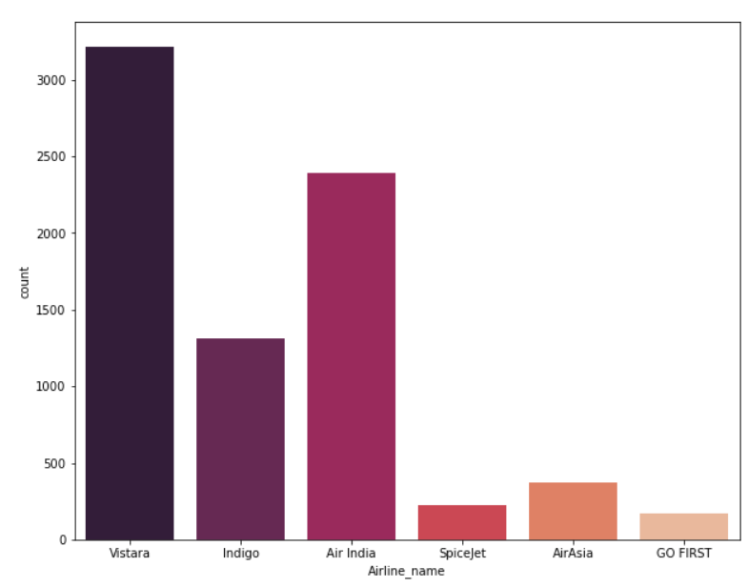
Visualization

Slide 17
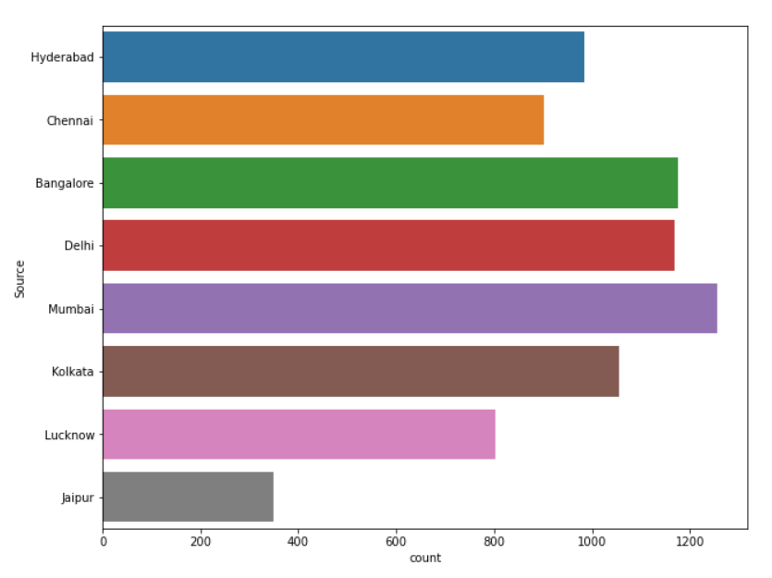
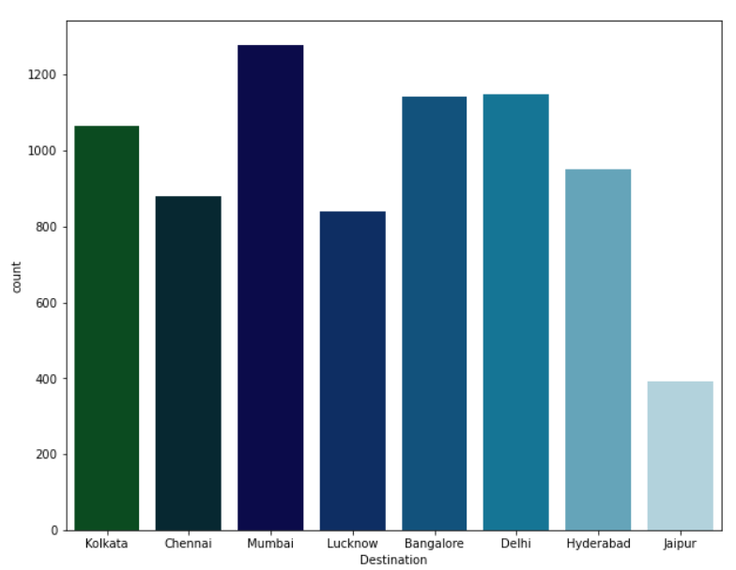

Slide 18
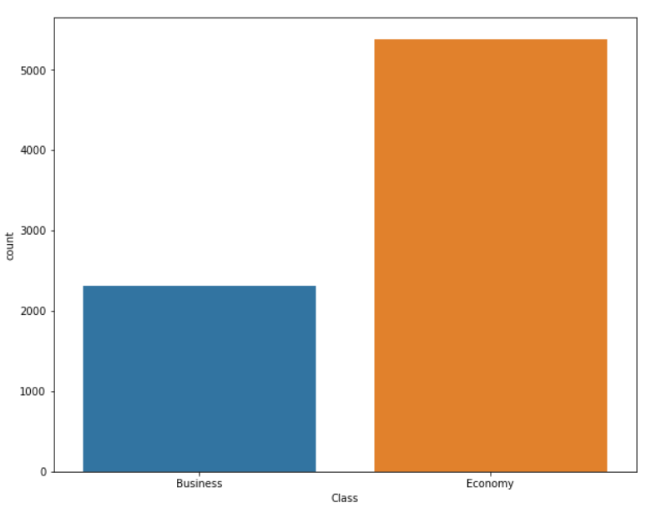
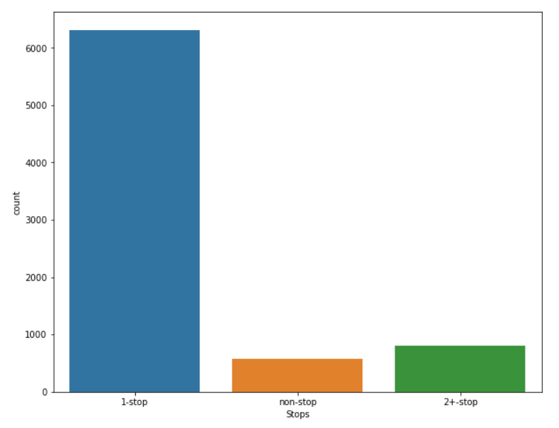

Slide 19
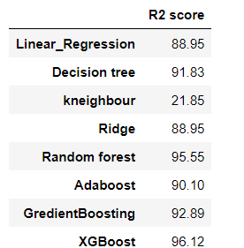
Vistara having a larget number of flights(3218) as compare to other airways.
Air india(2392) and Indigo(1314) airways standing over the 2nd and 3rd position and having good flights as comapre to others.
Spicejet(228), Air asia(373) and Go first(196) airways have a less number of flights as compare to others.
Destination- Mumbai(1279), Banglore(1143) and Delhi(1147) cities are the most preferable destination by the peoples.
Delhi, Kolkata ,Mumbai , Chennai and Banglore are the main source of flights but mumbai(1255),banglore(1176) and delhi(1169) is the most preferable source for all the airways.
When we see the total stops columns, Most of the flights takes one stopage(6314) and there are many flights also which takes zero stopage(576). Number of
2 stopage is very less.
CONCLUSION

Slide 20
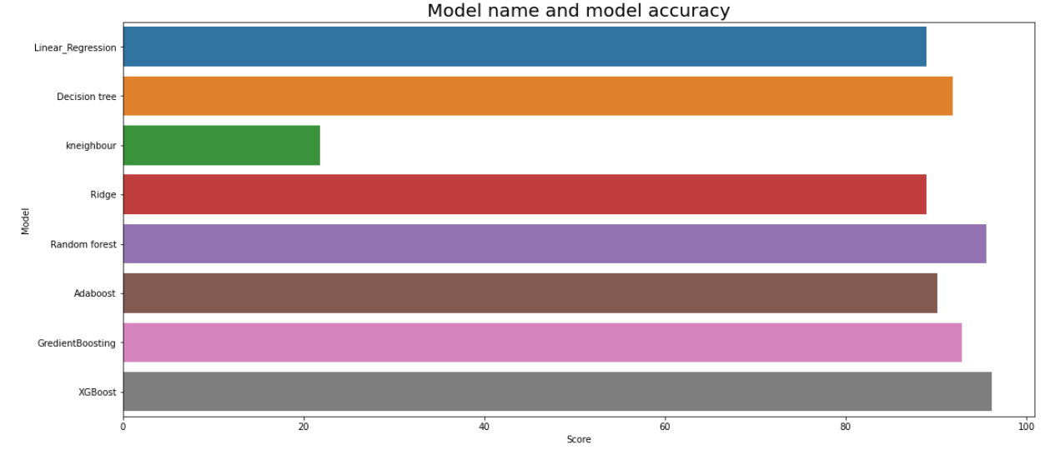
Best Model¶
We are chosing Random forest regressor as a best model, Because this model has least diffrence between model acuracy score and cross validation score and also its accuracy is highest as compare to others.That is why we are choosing RFR
Model accuracy is : 96.17 Cross_validation score : 95.54 Diffrence : 0.62
About XG boost regressor
XGBoost stands for Extreme Gradient Boosting, is a scalable, distributed gradient-boosted decision tree (GBDT) machine learning library. It provides parallel tree boosting and is the leading machine learning library for regression, classification, and ranking problems.
XGBoost is a powerful approach for building supervised regression models. The validity of this

Slide 21
statement (XGBoost) objective
can be inferred by knowing about its objective function and base learners. The
function contains loss function and a
regularization term.
In this paper, we built serveral predict the pricevarious flights compared each model to determine
regression models to
. We eveluated and the one with highest
performance. We also looked at how some models rank
the features according paper, we followed the with getting the data,
to their importance. In this data science process starting then cleaning and
preprocessing the data, followed by exploring the data and building models, then evaluating the results and communicating them with visualizations.

Slide 33




